Slide 1
Flexbox/Bootstrap/ Responsive Design
This week Study Overview

Slide 2
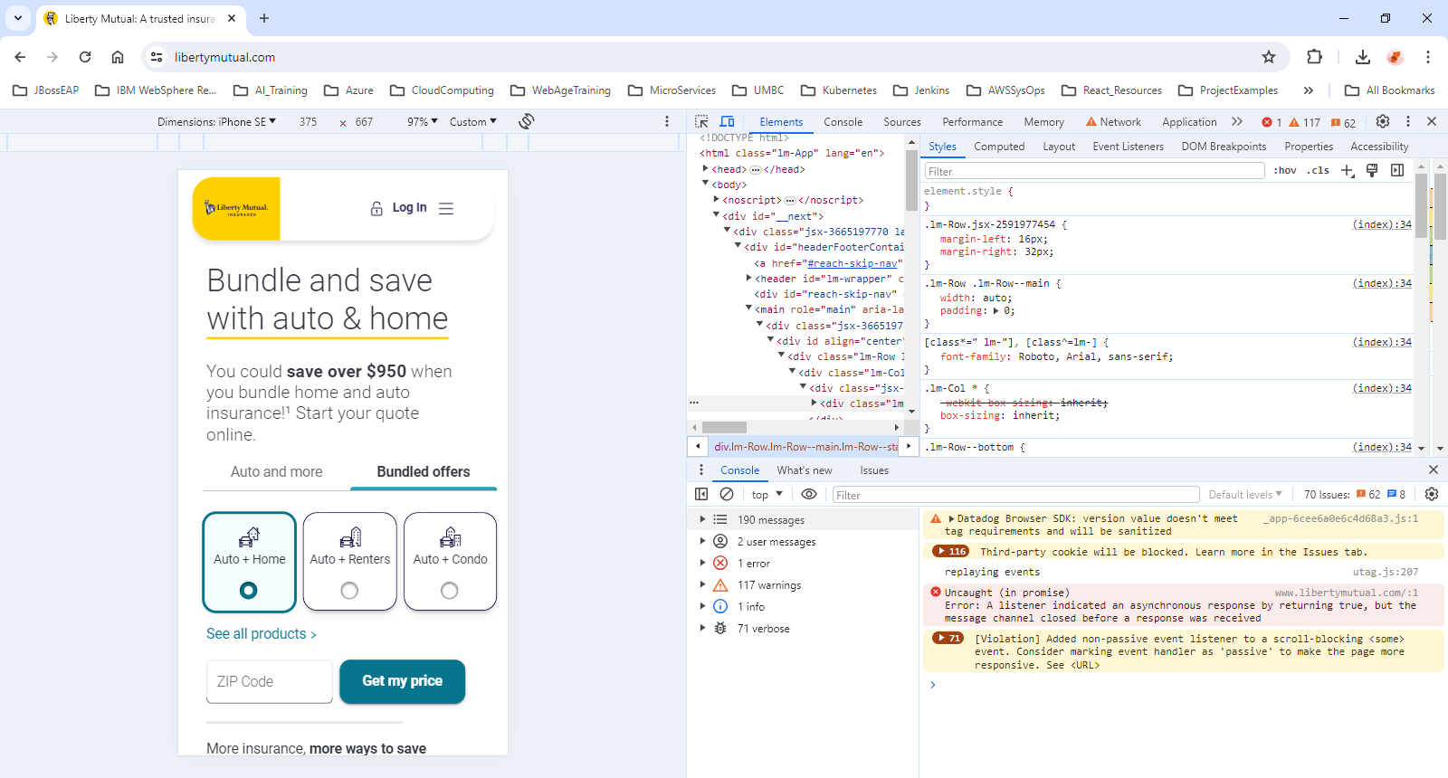
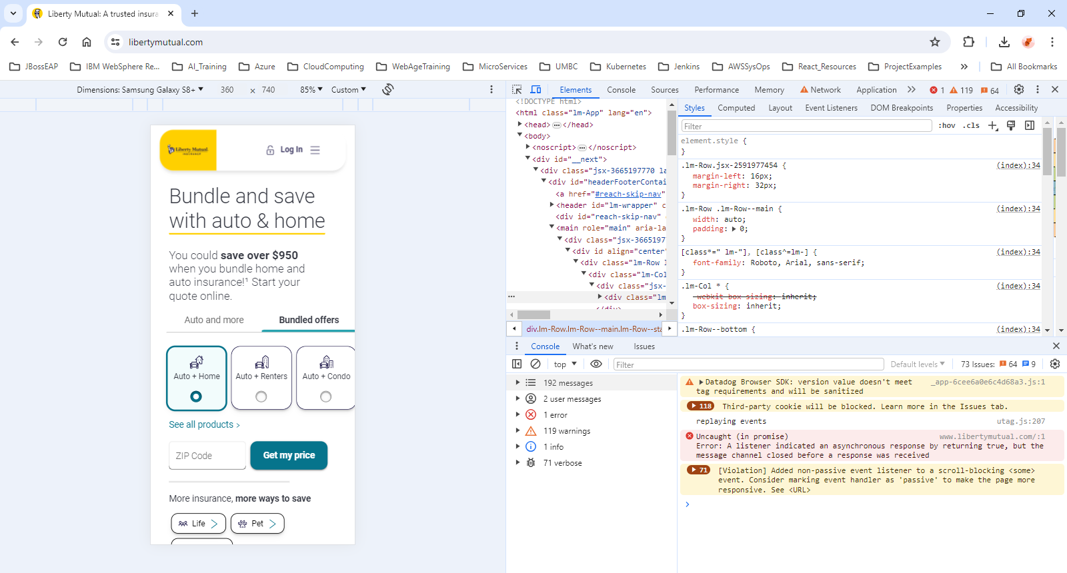
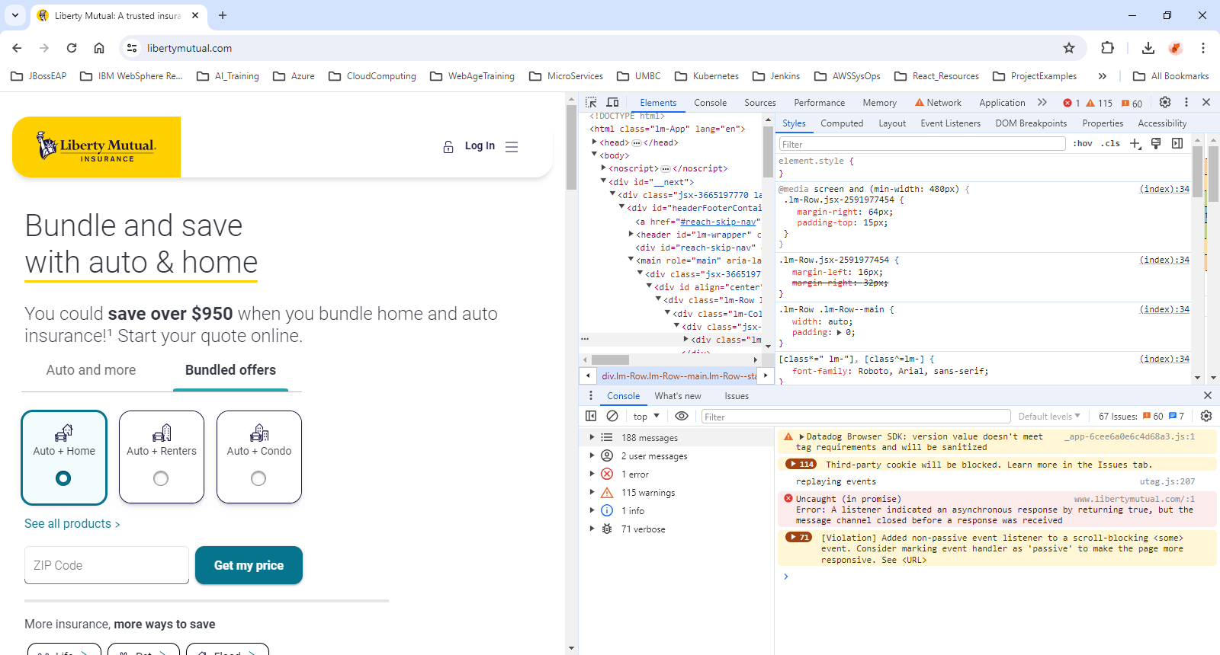
1. What is _______________?
Responsive Web Design?
create web pages that look good on all devices
A responsive web design will automatically adjust for different screen sizes and viewports
Viewport?
the visual area of a webpage as it is displayed on a device (smartphone or tablet) screen or monitor.
https://web.dev/blog/viewport-units

Slide 3
2. This week study overview
For all the coursework this week, a CODEPEN account will be helpful.
It’s free.
We suggest you use a personal email account.
Sign up here: https://codepen.io/
Flexbox Study
Study with Christina Truong
https://www.linkedin.com/learning/css-layouts-from-float-to-flexbox-and-grid/
An Overview of Page Layouts
Float, Display and Position
FlexBox
Grid – not required
Bootstrap Study
Study with Ray Villalobos
https://www.linkedin.com/learning/bootstrap-5-essential-training/
Getting Started
Essential Classes
Using Elements
Modifying Elements
© 2024 Web Age Solutions All rights reserved

Slide 4
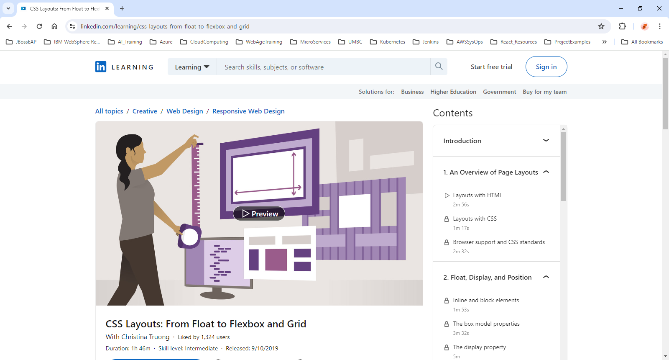

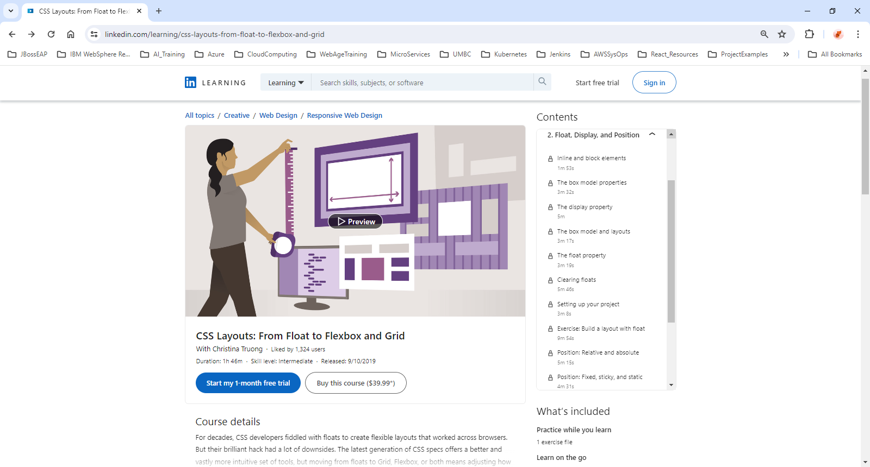
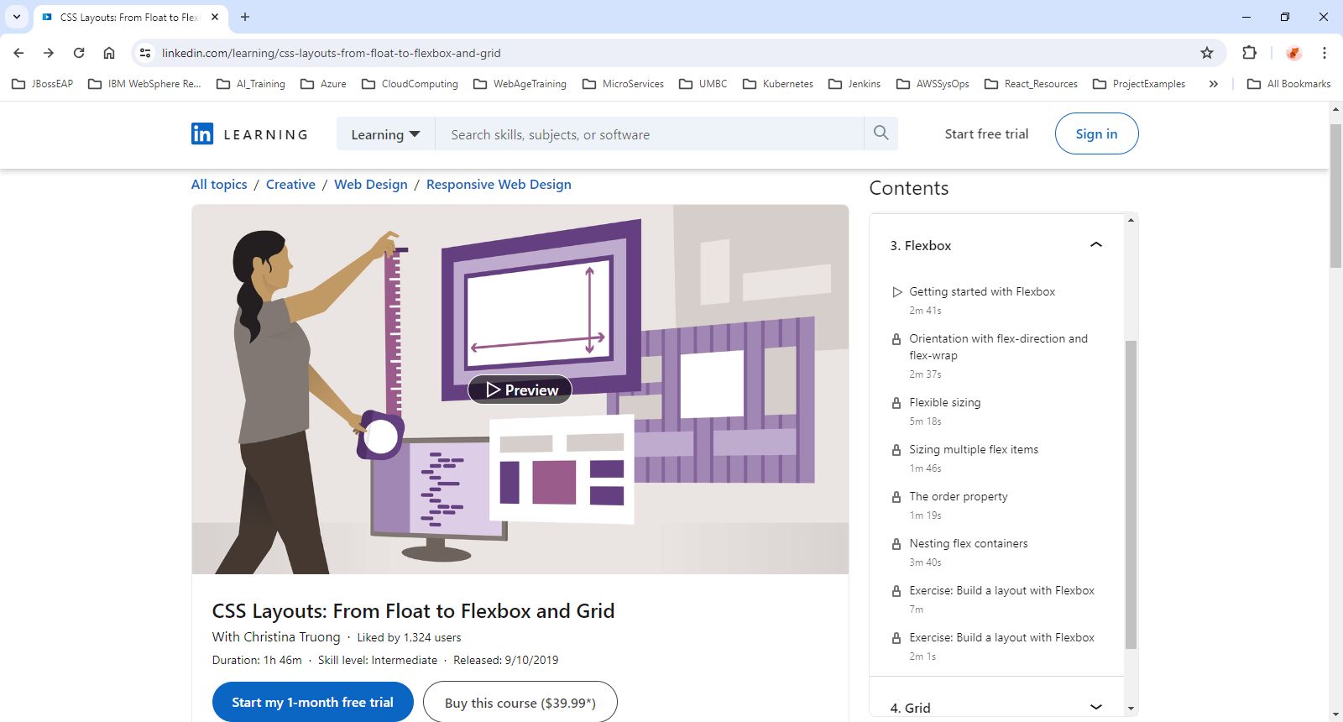
3. Flexbox Overview
https://www.linkedin.com/learning/css-layouts-from-float-to-flexbox-and-grid
© 2024 Web Age Solutions All rights reserved

Slide 5
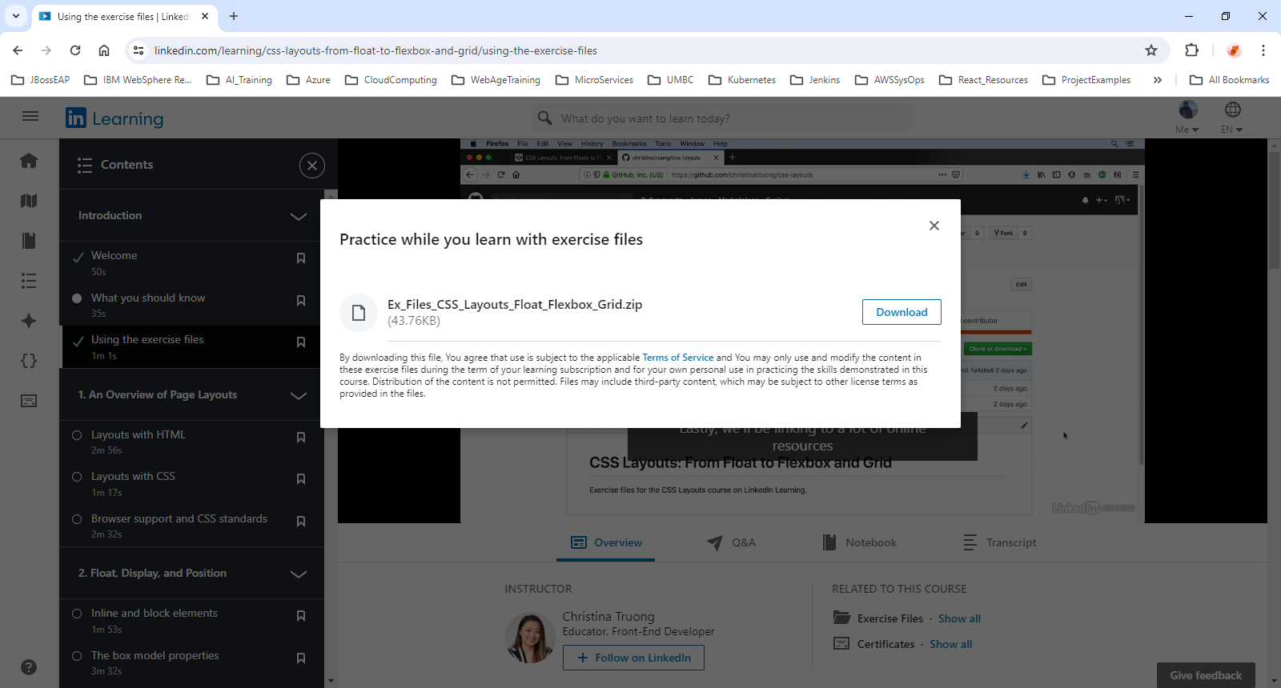
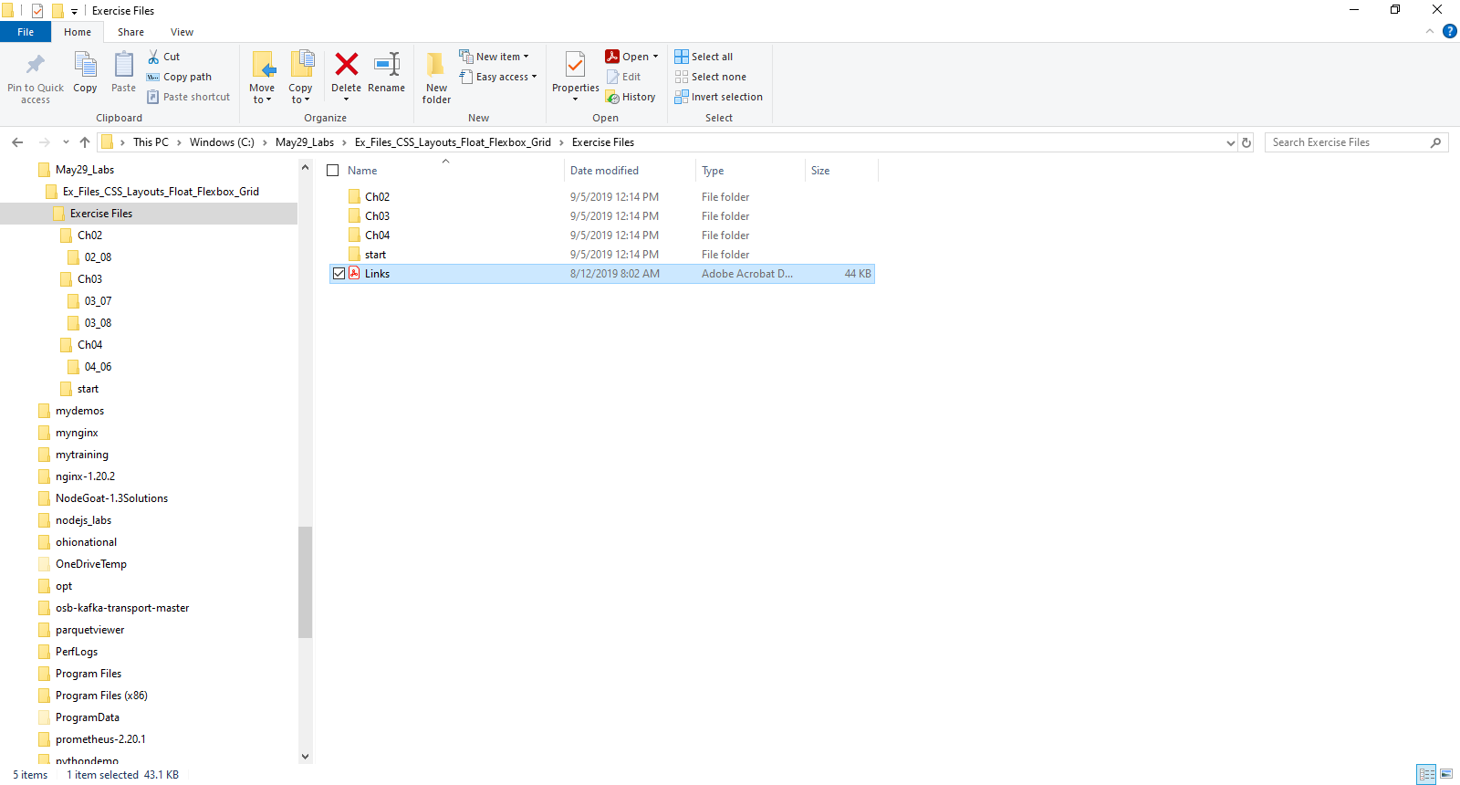
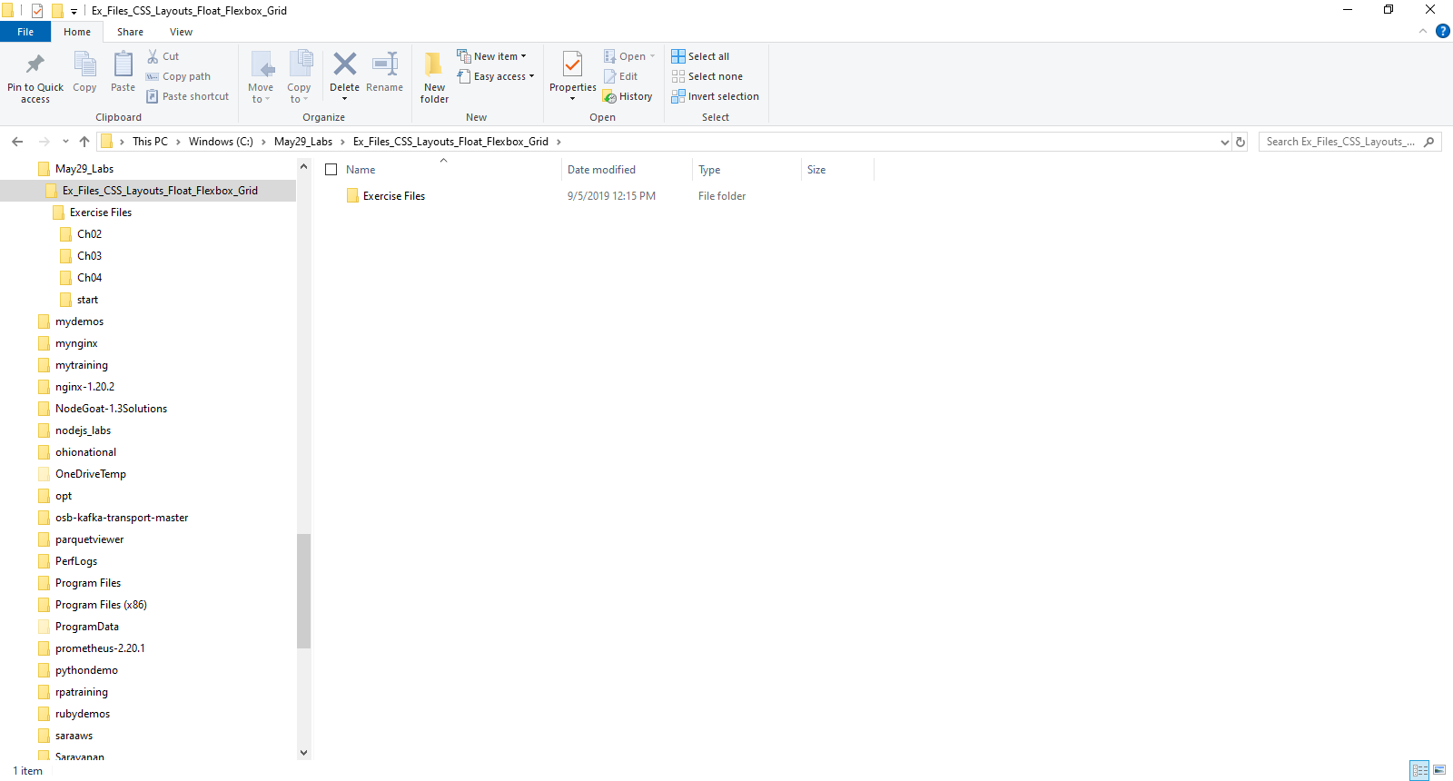
4. Flexbox Exercises and Exercise Files
Download LinkedIn Materials Exercises Files
Ex_Files_CSS_Layouts_Float_Flexbox_Grid.zip
Extract Exercises from Ex_Files_CSS_Layouts_Float_Flexbox_Grid.zip
into C:\May29_Labs

Slide 6
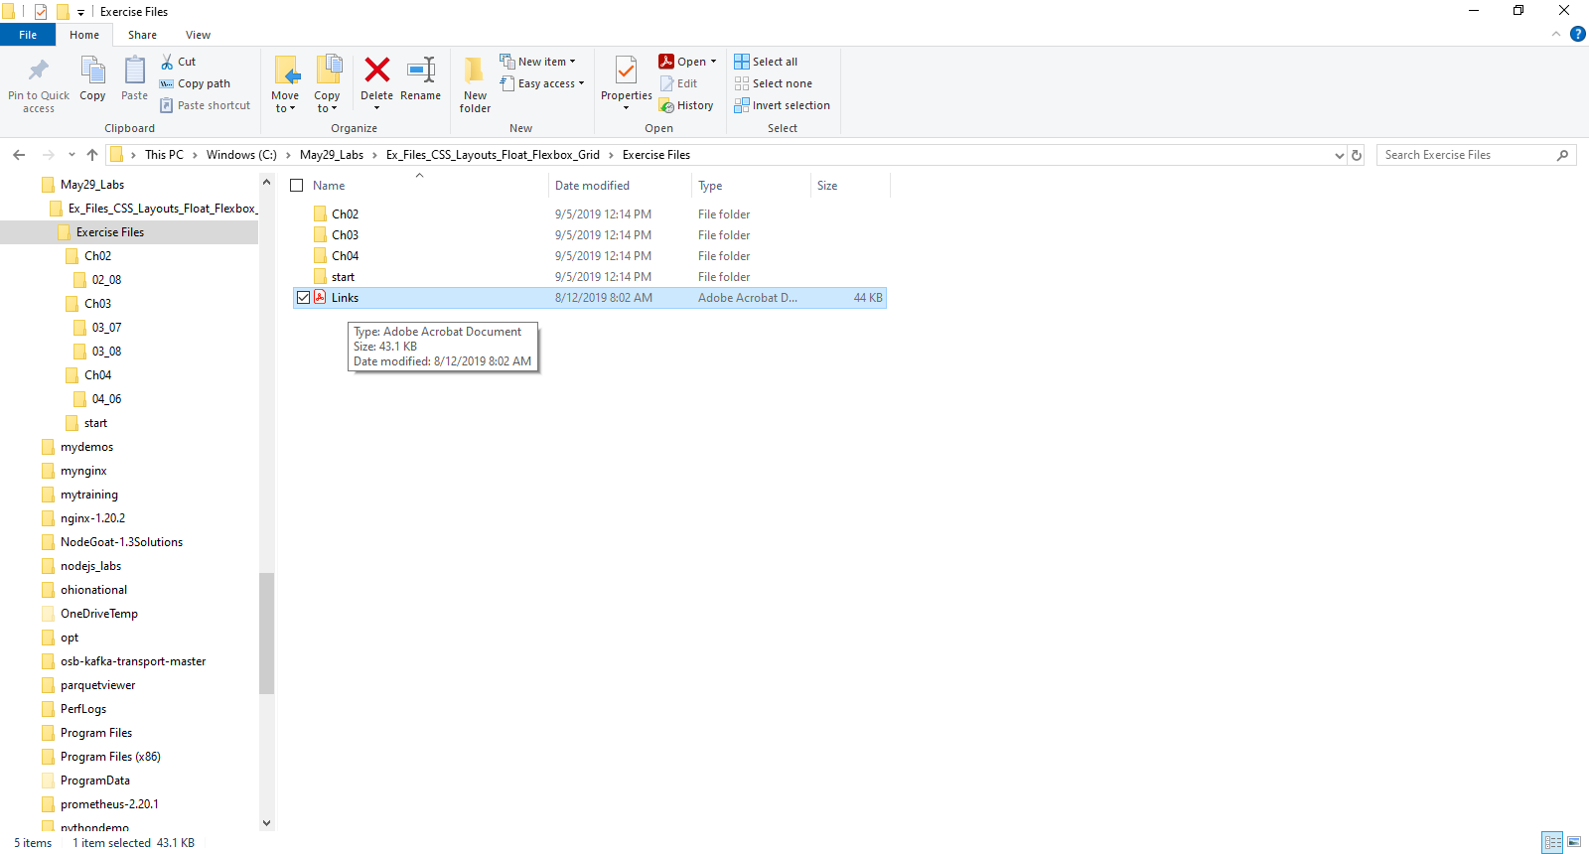
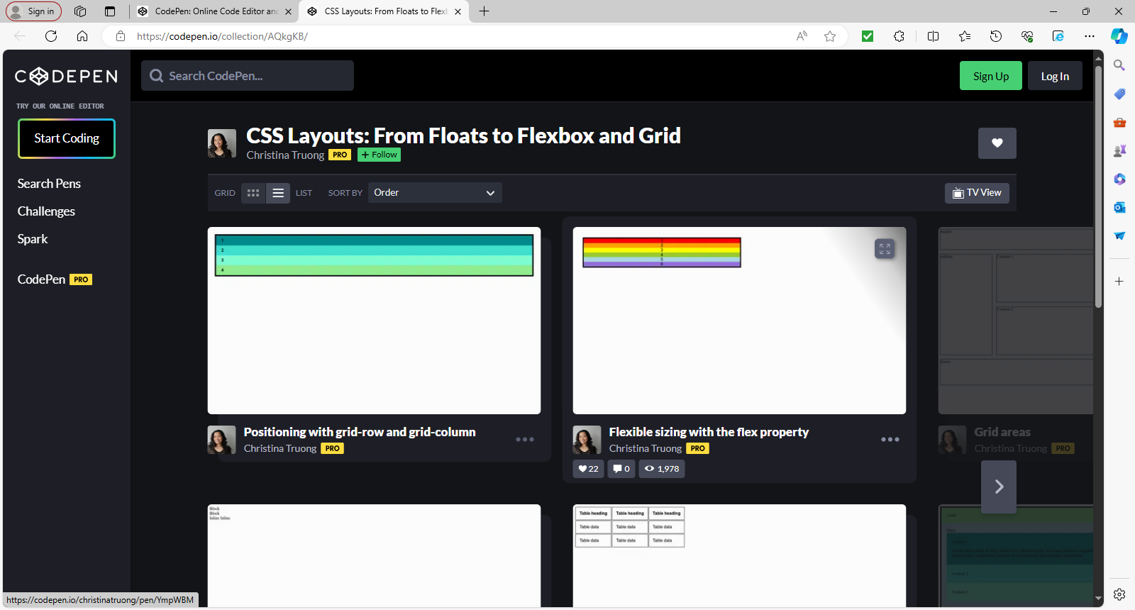
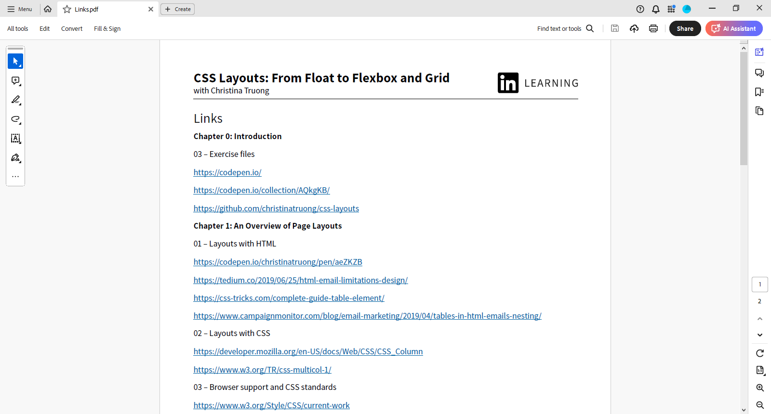
5. Code Pen Links and Resources

Slide 7
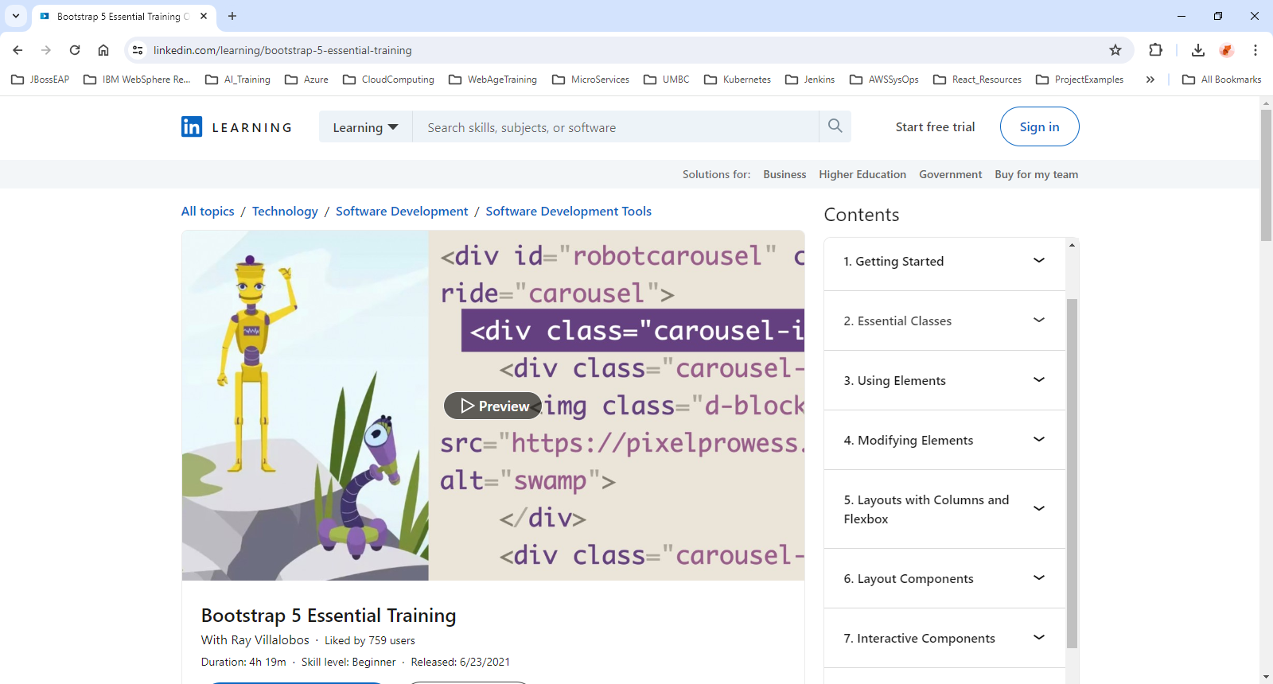


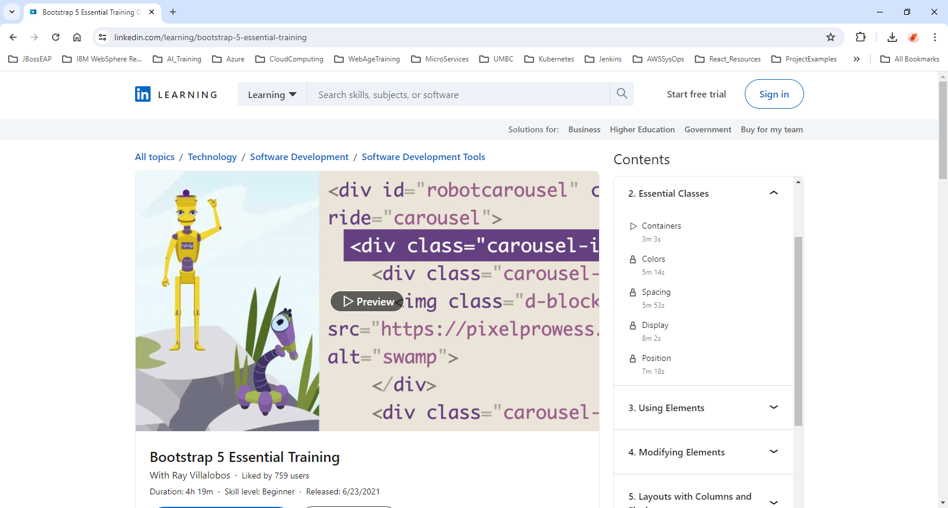

6. Bootstrap Overview
https://www.linkedin.com/learning/bootstrap-5-essential-training

Slide 8
7. Bootstrap Slides and Code Examples
There are no exercise files in this linked course.
BUT you can find all the code for this course at this URL:
raybo.org/slides_bootstrap5
This will take you to a slideshow with all the links you'll need for the course.
At the bottom of the slideshow, you'll find a navigation toolbar.
You can hit the t key to show or hide the toolbar.
If you hit the m key, you'll see an index of all the slides for the course.
If you click on a slide, that slide will play in your monitor.
At the beginning of each slide, there is an overlay with a link to the slide for that video.
If you're watching the video, you can jump to each of the slides at that URL

Slide 9
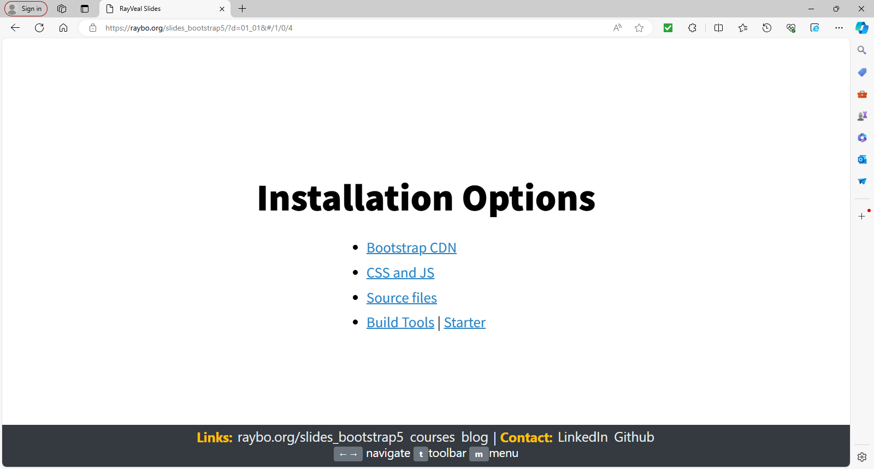
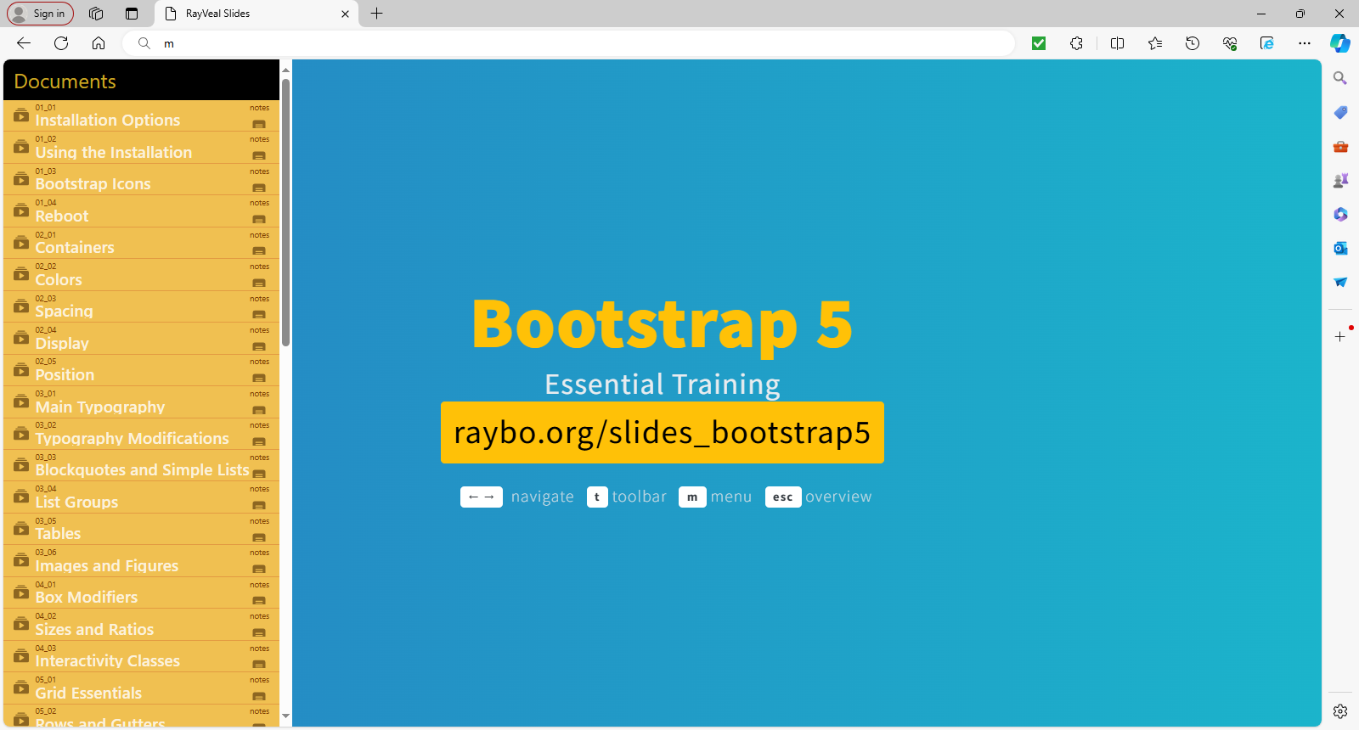
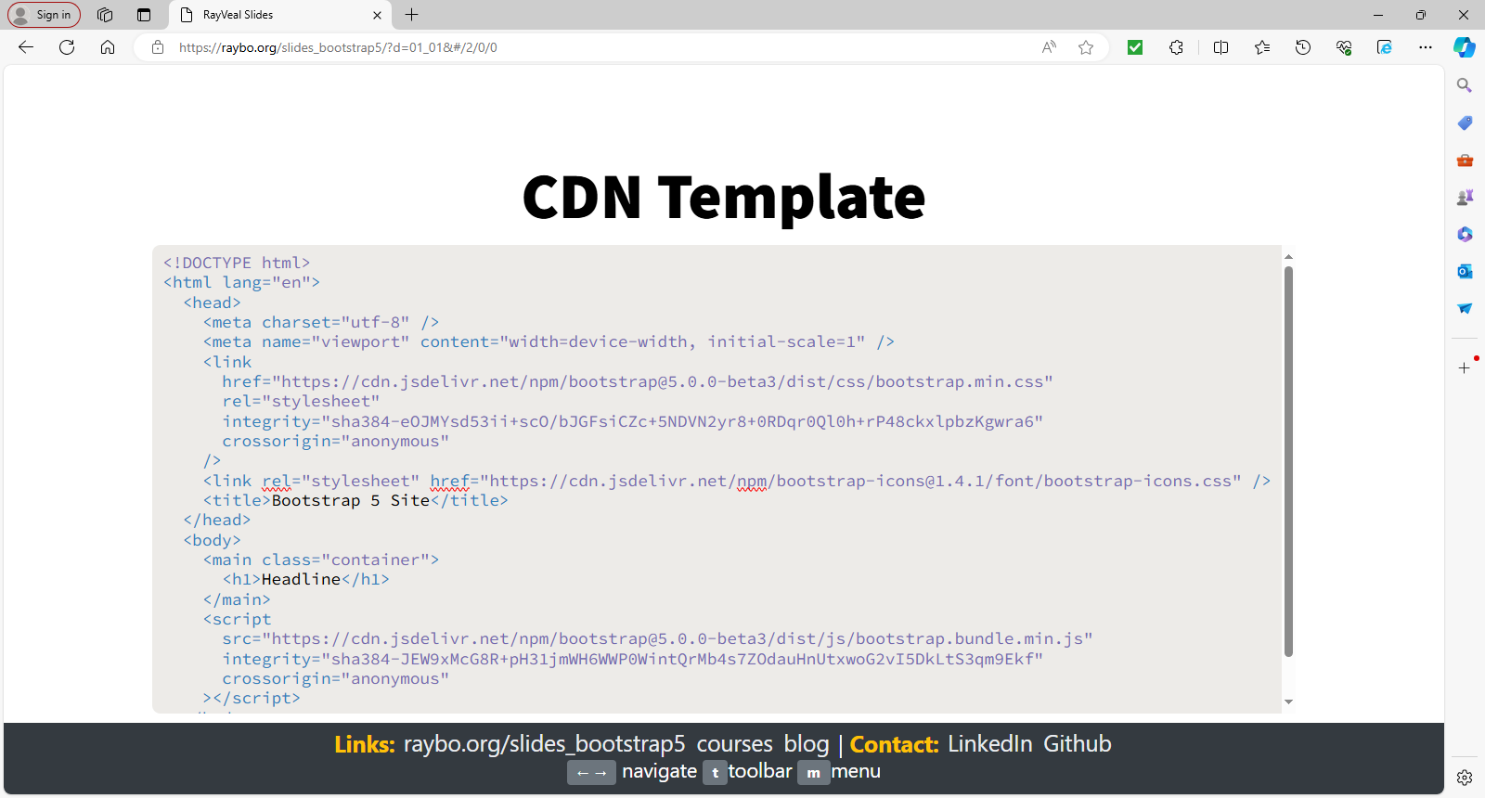
8. Bootstrap Slides and Code Examples
RayVeal Slides (raybo.org)

Slide 10
Additional Reading and Examples to Play
https://developer.mozilla.org/en-US/docs/Learn/CSS/CSS_layout/Flexbox
https://codepen.io/jsarachan/pen/XeaZLR
https://codepen.io/mikeyroy/pen/bNvPQJ
https://codepen.io/enxaneta/full/adLPwv/
https://freefrontend.com/css-flexbox-examples/
https://getbootstrap.com/
https://getbootstrap.com/docs/5.3/examples/
https://freefrontend.com/bootstrap-code-examples/
© 2024 Web Age Solutions All rights reserved

